Slide 1

JA COMPANY PROGRAM
PHASE 2: UNITE
WEEK 3

Slide 2

WEEK 3 AGENDA
PHASE 2: UNITE
ATTENDANCE & ICE BREAKER (20 MIN)
IDEA PITCHES (45 MIN)
COMPANY SELECTION (30 MIN)
BUSINESS MODEL CANVAS (45 MIN)
MISSION STATEMENT (10 MIN)
VENTURE FUNDING (25 MIN)
ENTREPRENUERIAL RESILIENCY MODULES (10 MIN)
QUESTIONS & WRAP UP (5 MIN)
Notes:
See the appendix at the end of the presentation to find optional activities.

Slide 3


WELCOME TO WEEK 3

Slide 4

COMPANY MISSION

Slide 5

Company Mission
Your company’s mission statement is your opportunity to define the company’s goals, ethics, culture and norms for decision making.
The best mission statements define a company’s goal in at least three dimensions: what the company does for its…
Customers
Employees
Owners
Community
World
Notes:
Company Mission (30 min)
Now that a product/service has been chosen, it is time to think about the Company Mission, Goals and Vision
Your company’s mission statement is your opportunity to define the company’s goals, ethics, culture, and norms for decision-making. The best mission statements define a company’s goals in at least three dimensions: what the company does for its customers, what it does for its employees, and what it does for its owners.
Other mission statements also include what the company does for its community and for the world.

Slide 6



Code of Ethics
Review the Code of Ethics Statement.
Each employee is required to sign the Code of Ethics agreement and return to the VP of Human Resources.
How would we feel if everyone knew about the decision we are making?
Notes:
Company Mission (30 min)
All participants are to review and understand the JA Code of Ethics statement.
The importance of using a Test of Disclosure should be emphasized.
Each employee is to sign the Code of Ethics agreement and returned to the VP of Human Resources.

Slide 7

Discussion
Who is your company?
What do you do? What do you stand for? Why do you do it?
Do you want to make a profit, or is it enough just to make a living?
What markets are you serving? What benefits do you offer them?
Do you solve a problem for your customers?
What kind of internal work environment do you want for your employees?
Notes:
Company Mission (30 min)
Facilitate a discussion using the questions on the slides.
Ask a student to take notes since they will need to refer back to this discussion in Phase 3 when the Mission Statement Template must be completed by the President.

Slide 8

Ice Breaker
SNAKE OIL
Pitch Your Product
Notes:
Ice breaker (15 min)
Conduct an ice-breaker with students
You can do the Snake Oil icebreaker or choose another one of your choice from the Team Builders and Ice Breakers document
This icebreaker can be done as a full team or in smaller groups to allow more participation from students. You may want to select only a few students to participate in the full group, then continue the activity in your small group meetings instead if you need more time for your pitches.
Make sure students are prepared to type or write down the words from the list.

Slide 9

Snake Oil
OBJECTIVE
We write problem on board, pitchers come up
With product to solve it.
Problem:
B2B- A chair manufacturing company has a
Problem with too many of their chairs being damaged in shipping.
B2C- Macy, a college student, always forgets to lock her door when she leaves her house.
Notes:
Ice Breaker (15 min)
Review the objective of the game and the instructions on the following slides.
Note: There are two types of cards within the set. One type of card is customer cards (12 in number), and the others are noun cards (60 in total).
Participants will try to convince each other that the product/service (from the noun deck) is appealing to a particular consumer (as chosen from the customer deck).
Reference the Snake Oil – Pitch Your Product Ice Breaker PDF for the instructions and the game cards. The game cards will need to be cut out prior to playing the game.

Slide 10



Instructions
THE CUSTOMER
Half class is customers
THE PITCHERS
Half class is pitchers.
Split into groups
Pitcher present product to customers
THE WINNER
After everyone has pitched their products, the customers decide which product he or she wants to purchase. This group is the winner. Roles then swap.
Notes:
Ice Breaker (15 min)
Advisor tip: It is helpful to demonstrate how the game works.
Have a mentor pick a customer card and share it with the group.
Another mentor can select six cards from the deck, and from those, select two cards as the name of their product/service.
The mentor can then pitch this product/service to the customer as described on the customer card.
Mentors should explain that the customer will only be allowed to choose one product or service to buy.
There are two variations of the activity, depending on the number of participants.
Variation 1 (1-12 participants)
One player selects a customer card. This is the person to whom everybody else is going to try to sell their product.
The other players each choose five cards from the noun deck, and from these five cards, choose two that, when combined, could be an appealing product for the customer to purchase.
Each player gets a turn to persuade the player with the customer card that his or her product is the best (a 30-second pitch is recommended). After everyone has pitched their products, the customer player decides which product he or she wants to purchase. This person becomes the winner and chooses a customer card.
Repeat steps to play as many rounds as time permits.
Wrap up after 15 minutes.
Variation 2 (13-30 participants)
Organize participants into groups of approximately ten players.
Follow steps 1-3 in variation 1. Repeat steps 1-3 until someone acquires three customer cards or, if time permits, a player has more cards than anyone else.
Mentors may ask participants to share winning product pitches with the entire group.

Slide 11
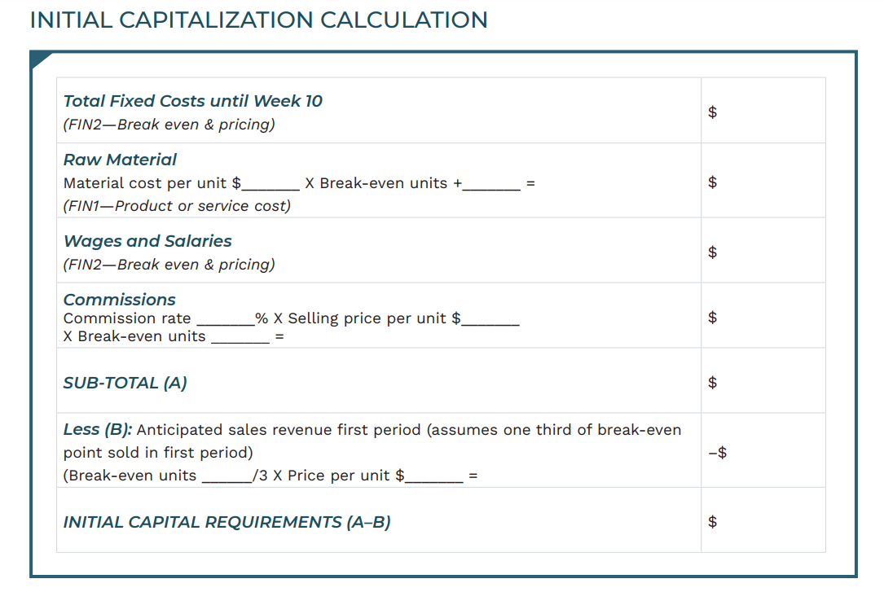
End of week 3

Slide 12
Start of week 4

Slide 13
IDEA PITCHES

Slide 14
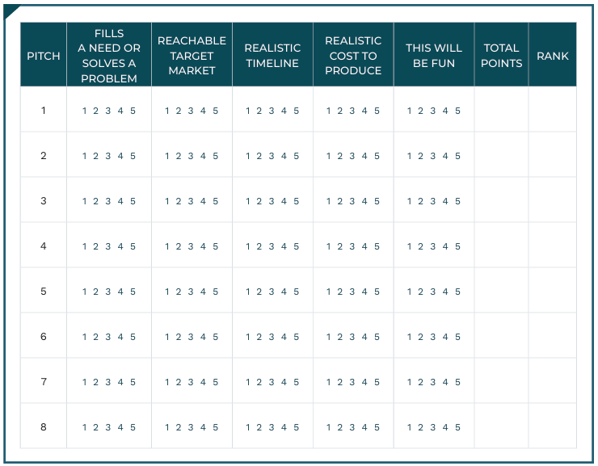

Idea Pitches
PITCH EVALUATION CRITERIA
Notes:
Idea Pitches (45 min)
Before the pitches:
Explain that participants will now present their pitches that they prepared at home, and the group will vote on the product/service idea that will be used moving forward.
Reminder: only groups/individuals with fully formed and researched ideas will pitch.
Before the pitches, thank everyone who put time into developing an idea. Remind the group that every idea has value and respect should be displayed.
Review the criteria for judging with the group.
Number students/groups and then draw a number to announce who will pitch.
Distribute the Pitch Evaluation Criteria worksheet. Ask students to listen to each pitch before recording points.

Slide 15




Pitch Your Idea!
Notes:
Idea Pitches (45 min)
During the pitches:
Keep the time limit to a maximum of one minute for each pitch. Questions are allowed after the pitches, but keep them to a minimum.
After the pitches:
After all of the pitches, Mentors will review judging sheets to review scores and narrow down to the top two to three products.
To determine the final idea, lead the group in an open pros and cons discussion about the top two to three chosen products/services. This will allow them to explore in more detail the viability of the product/service and identify potential challenges.
Once the discussion is done, the group can do a show of hands for the products/services or judge again using another method.

Slide 16
COMPANY SELECTION

Slide 17
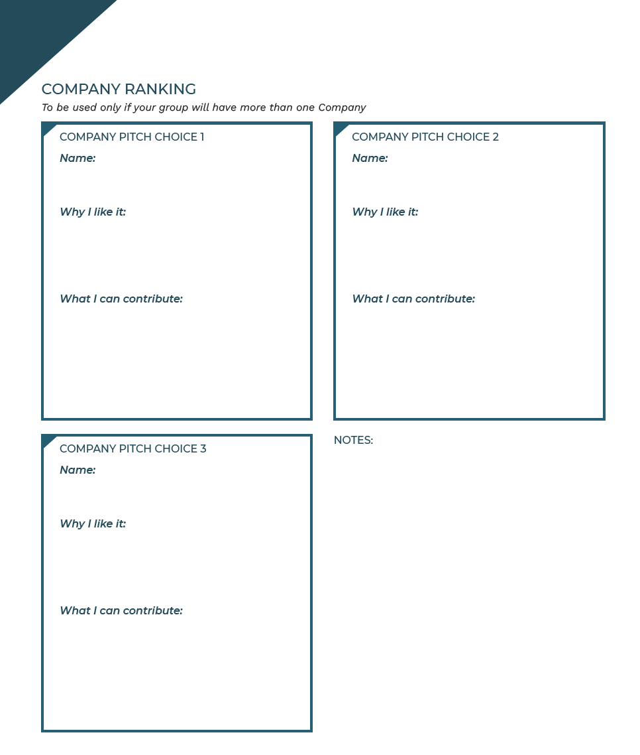
Company Selection
Use the Company Ranking sheet to rank your top 3 product choices in your personal order of preference (1-3).
Provide a reason for your ranking and share what you can bring to the team.
Notes:
Company Selection (30 min) – Only applicable if the group will have more than one company.
Once the final products or services have been selected by all the participants, hand each student a Company Ranking sheet.
They will rank their top choice product in their personal order of preference (1–3).
Each participant must submit this to volunteer before the end of the session. For the top three choices, participants must provide a reason for ranking. Their reason must speak about what they, individually, can bring to the team. Some participants may not wish to rank; they may be happy on any team. That is fine.
It is up to volunteers to review the selections and be ready to form the Companies next week.
Advisors must review selections and make their decisions before the next week.
Note: When choosing the mix of participants on teams, you should do your best to end with balanced company teams—balanced in terms of gender, age, interests, and any evidence to date of leadership strength. In balancing the company teams, you exercise great control over the outcome of the experience for all participants. Don’t squander your opportunity to help construct success by forming companies carefully. Try to understand the personalities of your group and ensure you are inclusive – placing shy or unsure kids with those who aren’t can work to foster company success by building a supportive team. There is a fit for every personality.

Slide 18
BUSINESS MODEL CANVAS
Notes:
Virtual facilitation note: Use the collaboration tool (i.e. Mural) assigned by your charter if you are delivering virtually.

Slide 19


Discussion
What contributes to or helps a company become successful?
Are goals and strategy important? Why?
Notes:
Business Canvas Model (45 mins)
Start this activity by having a discussion about why companies are successful using the prompts on the slide.
Bring students back to the concept of SMART goals explored in Week 2.
Explain that in order to be successful, they must put some time into planning.

Slide 20
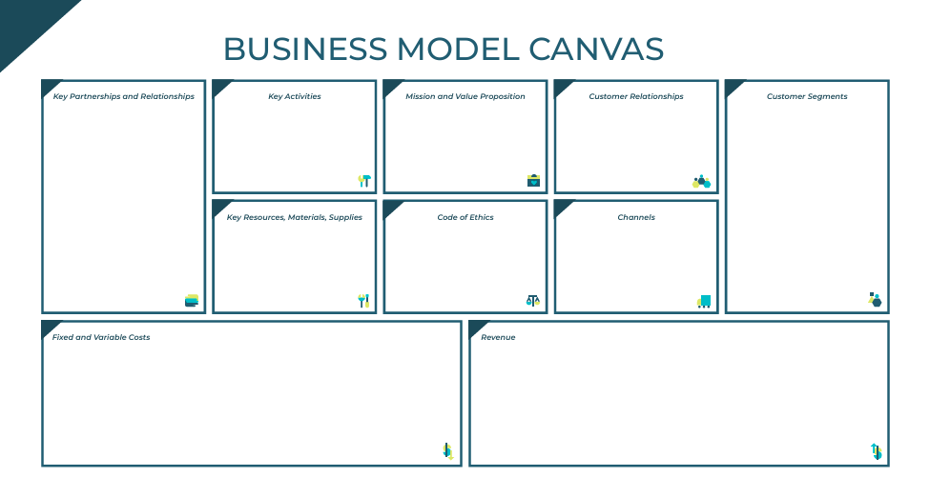
Business Model Canvas
The Business Model Canvas is a tool that helps to outline the details of a business.
It provides the structure of a business plan and delivers three things:
Focus – everyone will be on the same page.
Flexibility – easy to tweak the model and try new things.
Transparency – the team will have an easier time understanding the business model.
Notes:
Business Canvas Model (45 mins)
Together they will complete a Business Model Canvas. The Business Model Canvas will give them the structure of a business plan and fundamentally delivers three things.
Code of Ethics – the team will understand the underlying value of referring to the Test of Disclosure when making decisions.

Slide 21
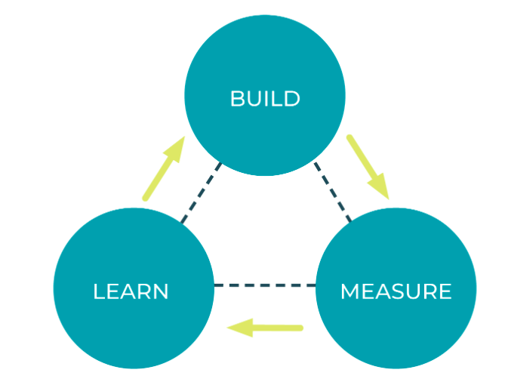
Lean Business Start-Up
There are three important steps in creating and maintaining a successful venture:
BUILD-MEASURE-LEARN
Notes:
Business Canvas Model (45 mins)
Discuss the concept from the lean business startup called “Build-Measure-Learn”.
Review each step on the following slides.

Slide 22

Lean Business Start-Up
BUILD
Form the company
Create a team
Make a product or service
Notes:
Business Canvas Model (45 mins)
Discuss the concept from the lean business startup called “Build-Measure-Learn”.

Slide 23

Lean Business Start-Up
MEASURE
How many sales are being made?
How efficient is production?
How effective are our employees?
Notes:
Business Canvas Model (45 mins)
Discuss the concept from the lean business startup called “Build-Measure-Learn”.

Slide 24

Lean Business Start-Up
LEARN
What can we take from what we’ve measured?
How do we improve?
What is working? What’s not?
Notes:
Business Canvas Model (45 mins)
Discuss the concept from the lean business startup called “Build-Measure-Learn”.

Slide 25
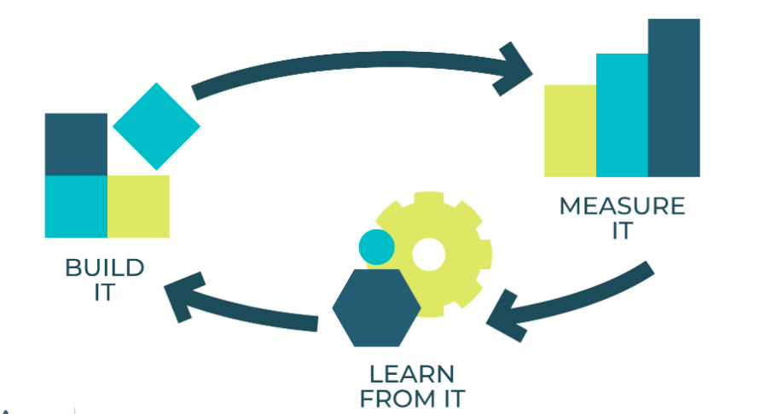
Lean Business Start-Up
A successful company is one that is constantly
re-evaluating itself.
By following
BUILD-MEASURE-LEARN, you can adapt more quickly and keep your customers happy!
Notes:
Business Canvas Model (45 mins)
Discuss the concept from the lean business startup called “Build-Measure-Learn”.
Ask the students, how could we apply this process to our company? What questions in the “Measure” section could we ask based on the product/service we’ve chosen?

Slide 26
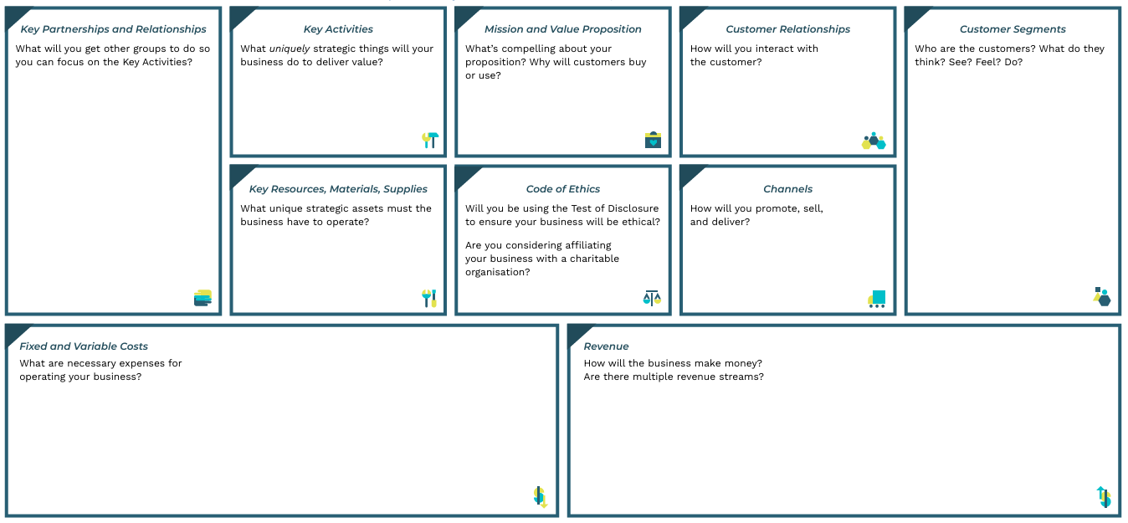
Business Model Canvas
Notes:
Business Canvas Model (45 mins)
Just like any other business, tell them that ensuring that their product/service and company are successful requires a process of evaluation throughout their operations.
Help students begin to complete their Business Model Canvas using the template provided. Students will have an opportunity to complete this in Phase 3.
Refer to the Business Model Canvas PDF.
There are additional videos about the Business Model Canvas available in the Appendix of the slide deck.
You can also visit this link: https://www.alexandercowan.com/business-model-canvas-templates/
Advisor tip: Walk through each section of the Business Model Canvas template to help students familiarize themselves before they get started.

Slide 27
VENTURE FUNDING

Slide 28



Venture Funding
JA Companies typically gain start-up funding by selling shares to investors.
Shares are units of ownership in a company.
Investors take equity in the business to help it get started and operate.
Pros
Shared risk
Access to capital
No obligation to pay initial investment back
Cons
Profit sharing
Pressure for growth
Loss of control
Notes:
Venture Funding (25 min)
Now that the product(s) or service(s) have been chosen, it is time for the group to determine their capitalization needs.

Slide 29


Venture Funding
JA Company Program Intro to Venture Capital - YouTube
Notes:
Venture Funding (25 min)
This video is optional as local offices have varying guidelines. If you would like to use it and include additional details on how your offices approach may differ, you can add a slide to do so.

Slide 30
Financing JA Company Program: Shares
COMMON SHARES
REQUIRED
Required for all members
Participate in profit share
Voting privileges
Independently purchased or subsidized
PREFERRED SHARES OPTIONAL
Not eligible for-profit share
No voting privileges
Members can purchase one preferred share
Managed as company expense and the face value (determined by the Company) plus dividend (20%)
Recommended: Teams value shares between $5-$20 and can raise a maximum of $300 through shares; teams requiring more can request approval from the local CP Manager
Notes:
Venture Funding (25 min)
Initial share value can be between $5.00 and $20.00.
Companies may choose to sell common shares only or both common and preferred shares.
Common Shares—Participate in the profit share of the company and entitle the holder to voting privileges. The purchase price is set by the Company; value at liquidation will depend on the profitability of the company.
Preferred Shares—Do not participate in the profit share or have voting privileges. Such shares should be treated as a company expense, and the face value (determined by the Company) plus dividend (20%) must be paid at liquidation. These shareholders will be paid out first during company liquidation.
Each company member must purchase a common share in the company to be an active company member with voting privileges. Members can also purchase one additional preferred share. If there are circumstances which would prevent a participant from purchasing a share, they should speak with their mentor team and/or Company Program Manager to make alternate arrangements. Such conversations will be held in strictest confidence.
Share certificates are included in the Optional Resources section of the Advisor Toolkit for Week 3 if you wish to use them.

Slide 31
Capitalization Requirements
JA Companies must complete the Capitalization Requirements Exercise.
The Capitalization Requirements Exercise will help to determine the funding needed for start-up.
Notes:
Venture Funding (25 min)
Companies must complete the Capitalization Requirements exercise to determine the funding needed for start-up. Prior to this, they must complete their break-even analysis.
Refer to the product/service cost, break even and pricing tools provided by your program manager to determine these numbers.
Check with your local Charter about JA Fixed Costs.
Companies should avoid over or under capitalization. Each company can raise a maximum of $300.00 for the purpose of capitalization (total combination of common and preferred). If additional start-up funding beyond $300 is required, the company must contact the Program Manager to obtain approval.
If the capital requirements exceed the revenue from the common share purchase, companies may choose to offer preferred shares to individuals outside the company membership (this may include volunteer mentors). The Company must vote to issue preferred shares and a majority must be in favour.
No single individual should own more than one common share and one preferred share in any one JA Company. Shares are non-transferable and non-legal. It is important to review the ethics behind buying another member’s share and not telling anyone you have done so. This does not pass the Test of Disclosure attached to the Code of Ethics (Would everyone be okay with the decision you are making?)
Once the share price is determined, encourage students to start bringing in their money as this process can take time and it is required before they can begin to purchase materials.
If a participant leaves the company program or other extenuating circumstances:
If a participant leaves the Company Program after purchasing a common share, that share will become a preferred share, payable at year-end with dividend. Any extenuating circumstances should be discussed with the Program Manager

Slide 32
ENTREPRENEURIAL RESILIENCY MODULES

Slide 33

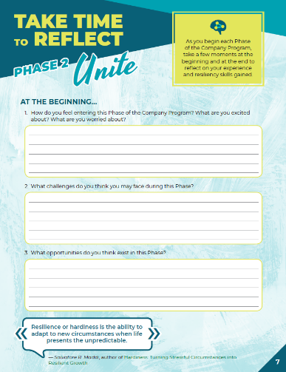

Company Program Resiliency Modules
Entrepreneurial resiliency is the ability to adapt to changes in your business and bounce back when things are challenging.
As you complete the JA Company Program, use this journal to reflect on your own resiliency and the skills you are gaining.
Notes:
Company Program Resiliency Modules (10 min)
Using the Company Program Resiliency Modules advisor guide, follow the instructions to guide students through the activities and discussions for Phase 2.

Slide 34
QUESTIONS & WRAP UP

Slide 35



Questions & Next Steps
QUESTIONS?
NEXT STEPS
Bring in share money next week
Notes:
Wrap-Up (5 min)
Create an opening for students to ask any questions about the meeting prior to wrapping up.
Remind students to complete incomplete tasks, to review progress and of what to prepare for the next meeting.
Review the next steps with students:
If the capitalization is complete, bring in share money next week.
Advisors:
Gather attendance records and any outstanding forms to share with the local JA Charter office.
If you were not able to cover any material, make a note and move it to your next meeting.
Address any questions, concerns or feedback to your Company Program Manager.
Executive Team Training (Outside of Regular Hours):
Learning opportunity for the student executives to attend and led by the local JA Charter. Check with your Company Program manager for more information.

Slide 36
APPENDIX
OPTIONAL ACTIVITIES
WEEK 3

Slide 37
BUSINESS MODEL CANVAS VIDEOS

Slide 38

Business Model Canvas
Ep 2 - Visualizing Your Business Model

Slide 39

Business Model Canvas
Business Model Canvas Explained

Slide 40
HOW TO FINANCE A START-UP

Slide 41






Other Ways to Raise Capital
There are many other ways to raise capital to finance a start up.
Personal Investments
Gift capital and crowdfunding
Debt Funding
Investors
Business Incubators
Grants
Notes:
How to Finance a Start-up (Optional)
While the process of selling shares can be a viable way to raise start-up capital and is used for JA Company program, there are other ways entrepreneurs can raise money to finance a start-up.

Slide 42

Personal Investments Bootstrapping
Bootstrapping is where you use your own personal investments, money or assets, for your start up costs.
Pros
You keep 100 percent of the control and profits
No interest or fees to pay for capital
Cons
Can limit the amount of money you have to get started
May impact lifestyle and ability to cover personal expenses
Notes:
Personal investment: your own money or assets
Bank loans: the most commonly used source of funding for small and medium-sized businesses.
Venture Capital: Capital provided to technology-driven companies with high-growth potential. The Venture Capital investors take equity in the business to help it carry out promising, but higher‑risk projects.
Angel Investment: Angels are generally wealthy individuals or retired company executives who invest directly in small firms owned by others. In return for risking their money, they reserve the right to supervise the company’s management practices.
Business incubators/accelerators: They generally focus on the high-tech sector by providing support for new businesses in various stages of development, such as office space, administrative and logistical resources and mentoring.
Grants, subsidies and tax credits: Government agencies funding. You may have access to this funding to help cover expenses, such as research and development, marketing, salaries, equipment and productivity improvement. Canada Business provides sources of financing, including government assistance.

Slide 43

Personal Investments Bootstrapping
Mailchimp, an email marketing platform, was founded in 2001. The founders bootstrapped the business for years without any venture capital.
By keeping the company profitable from the start and focusing on customers, Mailchimp grew into a highly successful company, valued at $12 billion when it was acquired by Intuit in 2021.

Slide 44

Gift Capital Family, Friends and Crowd funding
Gift capital is money gifted or loaned by a partner, parents, family or friends. Crowdfunding is where you reach out to a large pool of people to raise capital.
Pros
Limited or no interest or fees to pay for capital, and it may not need to be paid back
Flexible terms
Cons
Informal agreements can lead to misunderstandings
Can strain relationships and compromise reputation
Crowdfunding success rate may be lower than other finance options
Notes:
Do these investors get part ownership if the business succeeds? Do you have to pay money back if it fails?
These types of questions should be thoroughly discussed and agreements made in writing in advance.
A similar method is known as crowdfunding, in which you reach out to a large pool of people who contribute or invest a small amount, but they may not require a return on their investment.

Slide 45

Gift Capital Family, Friends and Crowd funding
Exploding Kittens, a quirky card game, raised over $8 million through a Kickstarter campaign in 2015, becoming one of the most successful crowdfunding campaigns for a game.
The game has since gone on to become widely popular.

Slide 46

Debt Funding Credit & Loans
Bank loans are the most commonly used source of funding for small and medium-sized businesses.
Using credit cards is also a form of debt funding.
Pros
Quick access to funding
Personal investment may increase motivation to succeed
Cons
Potentially higher interest charges and fees
May impact credit rating
Notes:
Debt funding & bank loans are the most commonly used source of funding for small and medium-sized businesses.
While this may seem like an easy option, it is not recommended because you retain all the risk and still have to pay off that debt plus interest even if the business venture fails.
An alternative may be to get a start-up loan from a bank, but banks will often look for collateral before they will provide you with a loan.

Slide 47


Debt Funding Credit & Loans
Bruce Poon Tip, JA Alumnus and founder of G Adventures, is a prominent figure in the global adventure travel company.
To get started, he used his personal credit cards to finance the company in 1990. With no external funding and limited resources, he went into debt to launch the business.
G Adventures is one of the largest adventure travel companies in the world, operating in over 100 countries.
Notes:
Discuss risks associated with leveraging personal debt and impact to wellbeing.
JA Company Program is a risk-free environment to test entrepreneurship.

Slide 48

Investors Angel & Venture Capitalists
Venture Capitalists take an equity in the business to help it carry out.
Angels are generally wealthy individuals or retired company executives who invest directly in small firms owned by others.
Pros
Flexible terms
May provide mentorship, advice and connections to networks
Access to capital
Cons
Lose some equity
Increased pressure to make money
Potential loss of control
Notes:
Venture Capital: Capital provided to technology-driven companies with high-growth potential. The Venture Capital investors take equity in the business to help it carry out promising, but higher‑risk projects.
Angel Investment: Angels are generally wealthy individuals or retired company executives who invest directly in small firms owned by others. In return for risking their money, they reserve the right to supervise the company’s management practices.
Advantages of Angel Investors:
Flexible Terms: Angel investors often offer more flexible terms compared to traditional financing.
Mentorship and Guidance: Many angel investors are experienced entrepreneurs who can provide valuable advice and mentorship.
Quick Decision-Making: Angels can make investment decisions faster than institutional investors.
Less Bureaucratic: The process is generally less formal and bureaucratic.
Disadvantages of Angel Investors:
Limited Funds: Angels typically invest smaller amounts compared to venture capitalists.
Limited Funds: Angels typically invest smaller amounts compared to venture capitalists.
Equity Dilution: You will need to give up a portion of your equity.
Potential for Conflict: Differences in vision or management style can lead to conflicts.
Less Structured Support: Angels may not provide the same level of structured support as venture capitalists.
Advantages of Venture Capitalists:
Access to Large Capital: Venture capitalists can provide significant amounts of funding, which is crucial for scaling operations.
Expertise and Mentorship: Venture capitalists often bring a wealth of industry expertise and strategic guidance.
Networking Opportunities: They can connect you with a vast network of industry contacts, potential partners, and future investors.
Credibility and Prestige: Securing venture capitalist funding can enhance your startup’s credibility and attract further investment.
Disadvantages of Venture Capitalists:
Loss of Control: Venture capitalists usually require a significant equity stake and may want a say in business decisions.
High Expectations: They often have high growth expectations, which can put pressure on the start-up.
Dilution of Ownership: Founders may experience significant dilution of their ownership.
Competitive and Time-Consuming: The process of securing venture capitalist funding is highly competitive and can be time-consuming.
Conclusion:
Choosing between angel investors and venture capitalists depends on your startup’s stage, funding needs, and growth plans.
Angels are great for early-stage funding and mentorship, while venture capitalists are better suited for scaling and accessing larger capital and networks.

Slide 49

Investors Angel & Venture Capitalists
Shopify, one of Canada's most successful tech companies, initially received angel investment from John Phillips, an early supporter who invested $250,000 in 2008.
This investment helped founders Tobias Lütke, Daniel Wein, and Scott Lake develop their e-commerce platform, which is now used by millions of merchants globally.
Shopify went public in 2015 and has grown into a multibillion-dollar company.

Slide 50

Business Incubators
Business incubators and accelerators generally focus on the high-tech sector by providing support for new businesses in various stages of development including space, admin resources and mentoring.
Pros
Access to resources in addition to funding
Credibility
Higher rate of success
Cons
Equity stake
Time commitment
May include restrictions
Notes:
Advantages:
Access to Funding: Incubators often provide seed funding or connect startups with potential investors, including venture capitalists and angel investors.
Mentorship and Guidance: Startups receive valuable mentorship from experienced entrepreneurs and industry experts.
Networking Opportunities: Incubators offer access to a network of other startups, investors, and business professionals, which can be crucial for growth.
Resources and Infrastructure: Many incubators provide office space, administrative support, and essential business services at low or no cost.
Increased Survival Rates: Startups in incubators tend to have higher survival rates due to the structured support and resources provided.
Disadvantages:
Equity Stake: Some incubators require an equity stake in exchange for their support, which can dilute the founders’ ownership.
Time Commitment: Participation in an incubator program can be time-consuming, often requiring a commitment of several months to a year.
Restrictions: Some incubators focus on specific industries or geographic areas, which may limit the options available to certain startups.
Potential for Dependency: Relying too heavily on the incubator’s resources and support.

Slide 51

Business Incubators
Ritual, a mobile ordering app for food and beverages, benefited from incubator support through Ryerson’s DMZ and later secured funding from government-backed sources such as FedDev Ontario.
Ritual has grown significantly, expanding to multiple cities in North America.

Slide 52

Grants Subsidies and Tax Credits
Canada offers a variety of grant subsidies and government funding options to support startup businesses.
Pros
You may not have to pay back the investment
Credibility and validation
Access to resources
Encourages innovation
Cons
Strict eligibility and may require extensive reporting
Competitive
Conditional funding
Notes:
Grants, subsidies and tax credits: Federal and Provincial Government agencies have funding, credits and subsidies available for businesses. You may have access to this funding to help cover expenses, such as research and development, marketing, salaries, equipment and productivity improvement. Canada Business provides sources of financing, including government assistance.
Federal Programs:
Industrial Research Assistance Program (IRAP): Provides financial support to small and medium-sized enterprises (SMEs) in Canada to help them undertake technology innovation.
Sustainable Development Technology Canada (SDTC): Offers funding for projects that aim to develop and demonstrate new environmental technologies.
Scientific Research and Experimental Development (SR&ED) Tax Credit: Provides tax incentives to encourage Canadian businesses to conduct research and development.
CanExport: Supports Canadian SMEs looking to explore new international markets through financial assistance for marketing and business development activities.
Canada Small Business Financing Program (CSBFP): Helps small businesses obtain loans from financial institutions by sharing the risk with lenders.
Provincial Programs:
Each province also offers its own set of grants and funding options. Here are a few examples:
Ontario: The Ontario Centre of Excellence (OCE) offers various funding programs to support innovation and commercialization.
British Columbia: The BC Tech Fund provides venture capital to startups in the technology sector.
Quebec: The Quebec Economic Development Program (QEDP) offers financial assistance to businesses for projects that contribute to the economic development of the province.
Other Support:
Wage Subsidies: Programs like the Canada Summer Jobs program provide wage subsidies to help businesses hire young workers.
Regional Development Agencies: Agencies like Western Economic Diversification Canada (WD) and Atlantic Canada Opportunities Agency (ACOA) offer various funding programs tailored to regional needs.
Leveraging government grants and subsidies can be a great way to support your startup, but it’s important to understand both the advantages and risks involved.
Advantages:
Non-Repayable Funds: Government grants are typically non-repayable, meaning you don’t have to pay back the money, which can significantly reduce financial pressure.
Financial Support: Grants and subsidies provide essential funding that can help cover various business expenses, such as research and development, hiring, and equipment.
Credibility and Validation: Receiving a government grant can enhance your startup’s credibility and validate your business idea, making it more attractive to investors and customers.
Access to Resources: Many government programs offer additional resources, such as mentoring, networking opportunities, and specialized training.
Encourages Innovation: Government funding often targets innovative projects, encouraging startups to develop new technologies and solutions.
Risks:
Strict Eligibility Requirements: Government grants often have stringent eligibility criteria, which can limit access to funding.
Time-Consuming Application Process: Applying for grants can be a lengthy and complex process, requiring detailed proposals and documentation.
Competitive: The competition for government grants can be intense, with many startups vying for limited funds.
Conditional Funding: Some grants come with specific conditions or requirements that must be met, which can restrict how you use the funds.
Dependency Risk: Relying too heavily on government.

Slide 53

Grants Subsidies and Tax Credits
CarbonCure Technologies secured significant funding through the Sustainable Development Technology Canada (SDTC) program, which supports clean technology innovations.
CarbonCure Technologies focuses on reducing the carbon footprint of concrete production, making it more environmentally friendly.

Slide 54

Other Important Factors
Consider the stress factors entrepreneurs might face when financing as start-up.
What strategies might be helpful to ensure they can maintain their well being?
Self-care and stress
management are essential skills for an entrepreneur.

